Slide 1

Department of Computer Science
University Institute of Engineering
DEPARTMENT OF COMPUTER SCIENCE & ENGINEERING
Bachelor of Engineering
Subject Name: System Programming
Subject Code: CST-315
Assemblers
DISCOVER . LEARN . EMPOWER

Slide 2
Chapter-1.2 Assemblers
Department of computer Science
Single pass Assembler for Intel x86
Algorithm of Single Pass Assembler

Slide 3
Single pass Assembler for Intel x86
Instructions
• Assembled into machine code by assembler
• Executed at runtime by the CPU
• Member of the Intel IA-32 instruction set
It is divided into Four parts
• Label (optional)
• Mnemonic (required)
• Operand (usually required)
• Comment (optional) Label: Mnemonic Operand(s) ;Comment

Slide 4
Single pass Assembler for Intel x86
Labels
• Act as place markers
• marks the address (offset) of code and data
• Easier to memorize and more flexible
eg. mov ax, [0020]→mov ax, val
• Follow identifier rules
Data label
• must be unique
example: myArray BYTE 10
• Code label (ends with a colon)
• target of jump and loop instructions
example: L1: mov ax, bx ... jmp L1

Slide 5
Single pass Assembler for Intel x86
Reserved words and identifiers
• Reserved words cannot be used as identifiers
•Instruction mnemonics, directives, type attributes, operators, predefined symbols
• Identifiers
• 1-247 characters, including digits
• case insensitive (by default)
• first character must be a letter, _, @, or $
examples: var1 Count $first _main MAX open_file @@myfile xVal _12345

Slide 6
Single pass Assembler for Intel x86
Comments • Comments are good! • explain the program's purpose • tricky coding techniques • application-specific explanations • Single-line comments • begin with semicolon (;) • block comments • begin with COMMENT directive and a programmer-chosen character and end with the same programmer-chosen character COMMENT ! This is a comment and this line is also a comment !
directive marking a comment comment copy definitions from Irvine32.inc code segment. 3 segments: code, data, stack beginning of a procedure destination source defined in Irvine32.inc to end a program marks the last line and define the startup procedure Example: adding/subtracting integers TITLE Add and Subtract (AddSub.asm) ; This program adds and subtracts 32-bit integers.
Defining data
Intrinsic data types (1 of 2) • BYTE, SBYTE • 8-bit unsigned integer; 8-bit signed integer • WORD, SWORD • 16-bit unsigned & signed integer • DWORD, SDWORD • 32-bit unsigned & signed integer • QWORD • 64-bit integer • TBYTE • 80-bit integer
Intrinsic data types (2 of 2) • REAL4 • 4-byte IEEE short real • REAL8 • 8-byte IEEE long real • REAL10 • 10-byte IEEE extended real
Data definition statement • A data definition statement sets aside storage in memory for a variable. • May optionally assign a name (label) to the data. • Only size matters, other attributes such as signed are just reminders for programmers. • Syntax: [name] directiveinitializer [,initializer] . . . At least one initializer is required, can be ? • All initializers become binary data in memory
Integer constants • [{+|-}] digits [radix] • Optional leading + or – sign • binary, decimal, hexadecimal, or octal digits • Common radix characters: • h– hexadecimal • d– decimal (default) • b– binary • r– encoded real • o– octal Examples: 30d, 6Ah, 42, 42o, 1101b Hexadecimal beginning with letter: 0A5h

Slide 7
Single pass Assembler for Intel x86
Integer expressions • Operators and precedence levels: • Examples:
Real number constants (encoded reals) • Fixed point v.s. floating point • Example 3F800000r=+1.0,37.75=42170000r • double 1 8 23 S E M ±1.bbbb×2 (E-127) 1 11 52 S E M
Real number constants (decimal reals) • [sign]integer.[integer][exponent] sign → {+|-} exponent → E[{+|-}]integer • Examples: 2. +3.0 -44.2E+05 26.E5
Character and string constants • Enclose character in single or double quotes • 'A', "x" • ASCII character = 1 byte • Enclose strings in single or double quotes • "ABC" • 'xyz' • Each character occupies a single byte • Embedded quotes: • ‘Say "Goodnight," Gracie’ • "This isn't a test"
Defining BYTE and SBYTE Data Each of the following defines a single byte of storage: value1 BYTE 'A‘ ; character constant value2 BYTE 0 ; smallest unsigned byte value3 BYTE 255 ; largest unsigned byte value4 SBYTE -128 ; smallest signed byte value5 SBYTE +127 ; largest signed byte value6 BYTE ? ; uninitialized byte A variable name is a data label that implies an offset (an address).
Defining multiple bytes Examples that use multiple initializers: list1 BYTE 10,20,30,40 list2 BYTE 10,20,30,40 BYTE 50,60,70,80 BYTE 81,82,83,84 list3 BYTE ?,32,41h,00100010b list4 BYTE 0Ah,20h,‘A’,22h
Defining strings (1 of 2) • A string is implemented as an array of characters • For convenience, it is usually enclosed in quotation marks • It usually has a null byte at the end • Examples: str1 BYTE "Enter your name",0 str2 BYTE 'Error: halting program',0 str3 BYTE 'A','E','I','O','U' greeting1 BYTE "Welcome to the Encryption Demo program " BYTE "created by Kip Irvine.",0 greeting2 \ BYTE "Welcome to the Encryption Demo program " BYTE "created by Kip Irvine.",0
Defining strings (2 of 2) • End-of-line character sequence: • 0Dh = carriage return • 0Ah = line feed str1 BYTE "Enter your name: ",0Dh,0Ah BYTE "Enter your address: ",0 newLine BYTE 0Dh,0Ah,0 Idea: Define all strings used by your program in the same area of the data segment.

Slide 8
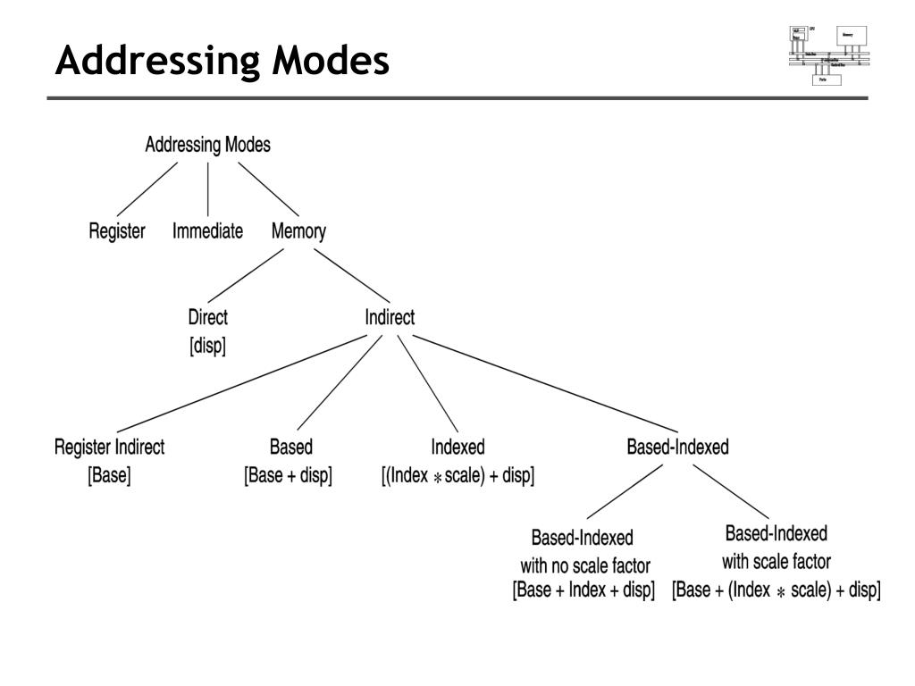
Single pass Assembler for Intel x86

Slide 9
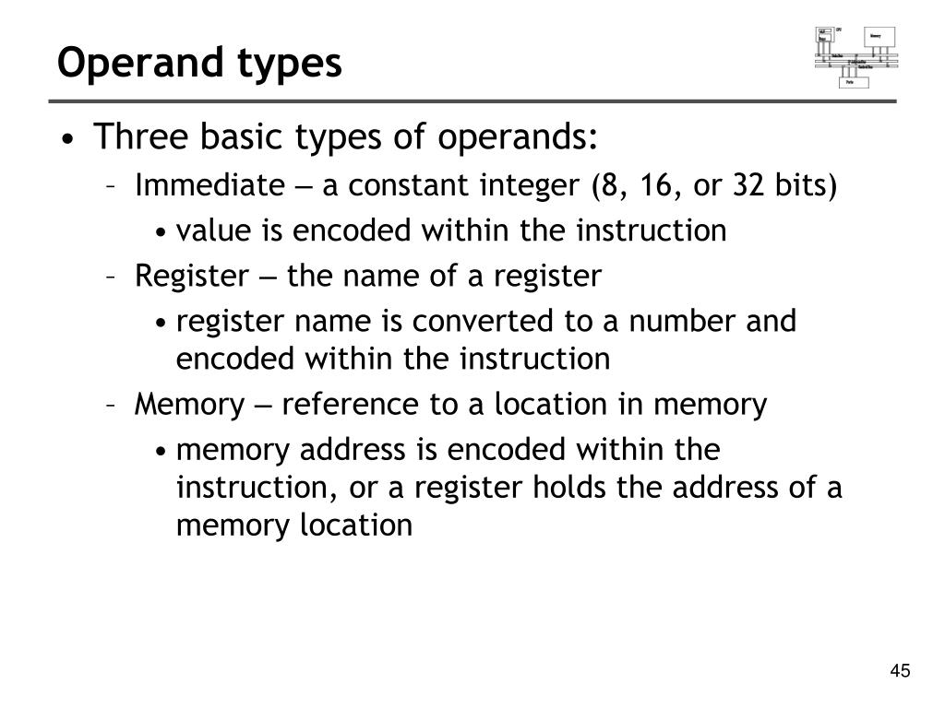
Single pass Assembler for Intel x86

Slide 10
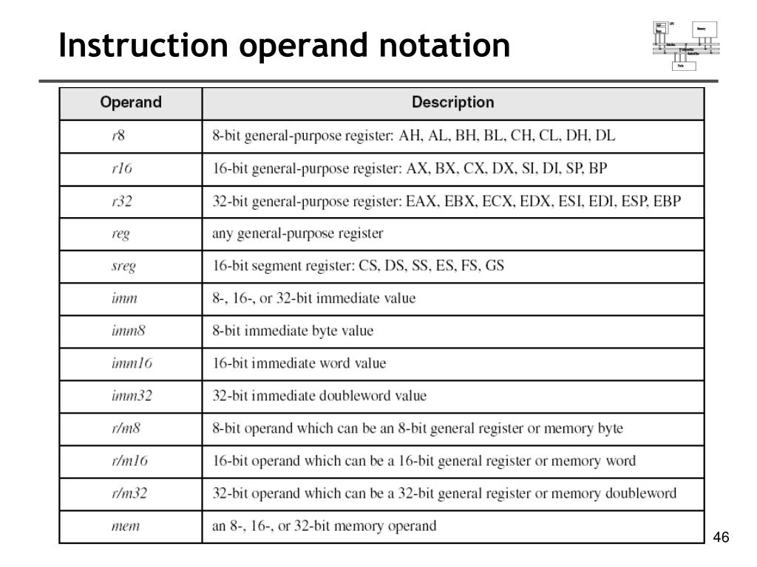
Single pass Assembler for Intel x86
:

Slide 11
Single Pass Storage algorithm
One-pass assemblers are used when
it is necessary or desirable to avoid a second pass over the source program the external storage for the intermediate file between two passes is slow or is inconvenient to use Main problem: forward references to both data and instructions.
Data Structures Required are:
Op code table
Symbol table
pass 1: loop until the end of the program 1. Read in a line of assembly code 2. Assign an address to this line increment N (word addressing or byte addressing)
3. Save address values assigned to labels in symbol tables
4. Process assembler directives constant declaration space reservation

Slide 12
Single Pass Storage algorithm
Algorithm for Pass 1 assembler:
begin
if starting address is given LOCCTR = starting address; else LOCCTR = 0;
while OPCODE != END do ;; or EOF begin read a line from the code if there is a label
if this label is in SYMTAB, then error else insert (label, LOCCTR) into SYMTAB
search OPTAB for the op code if found LOCCTR += N ;; N is the length of this instruction (4 for MIPS) else if
this is an assembly directive update LOCCTR as directed else error write line to intermediate file
end
program size = LOCCTR - starting address; end

Slide 13
References
PPT - Intel x86 Assembly Fundamentals PowerPoint Presentation, free download - ID:4403217 (slideserve.com)
Introduction to software | computer Software (w3htmlschool.com)
Types of Software – GeeksforGeeks

Slide 14

THANK YOU

